Slide 1
Contractor Safety Management
Presented by Dan Donovan
Senior Consultant, G.E.W. LLC
206.399.8801
dandonovan@GEW-LLC.com
www.GEW-LLC.com

Slide 2
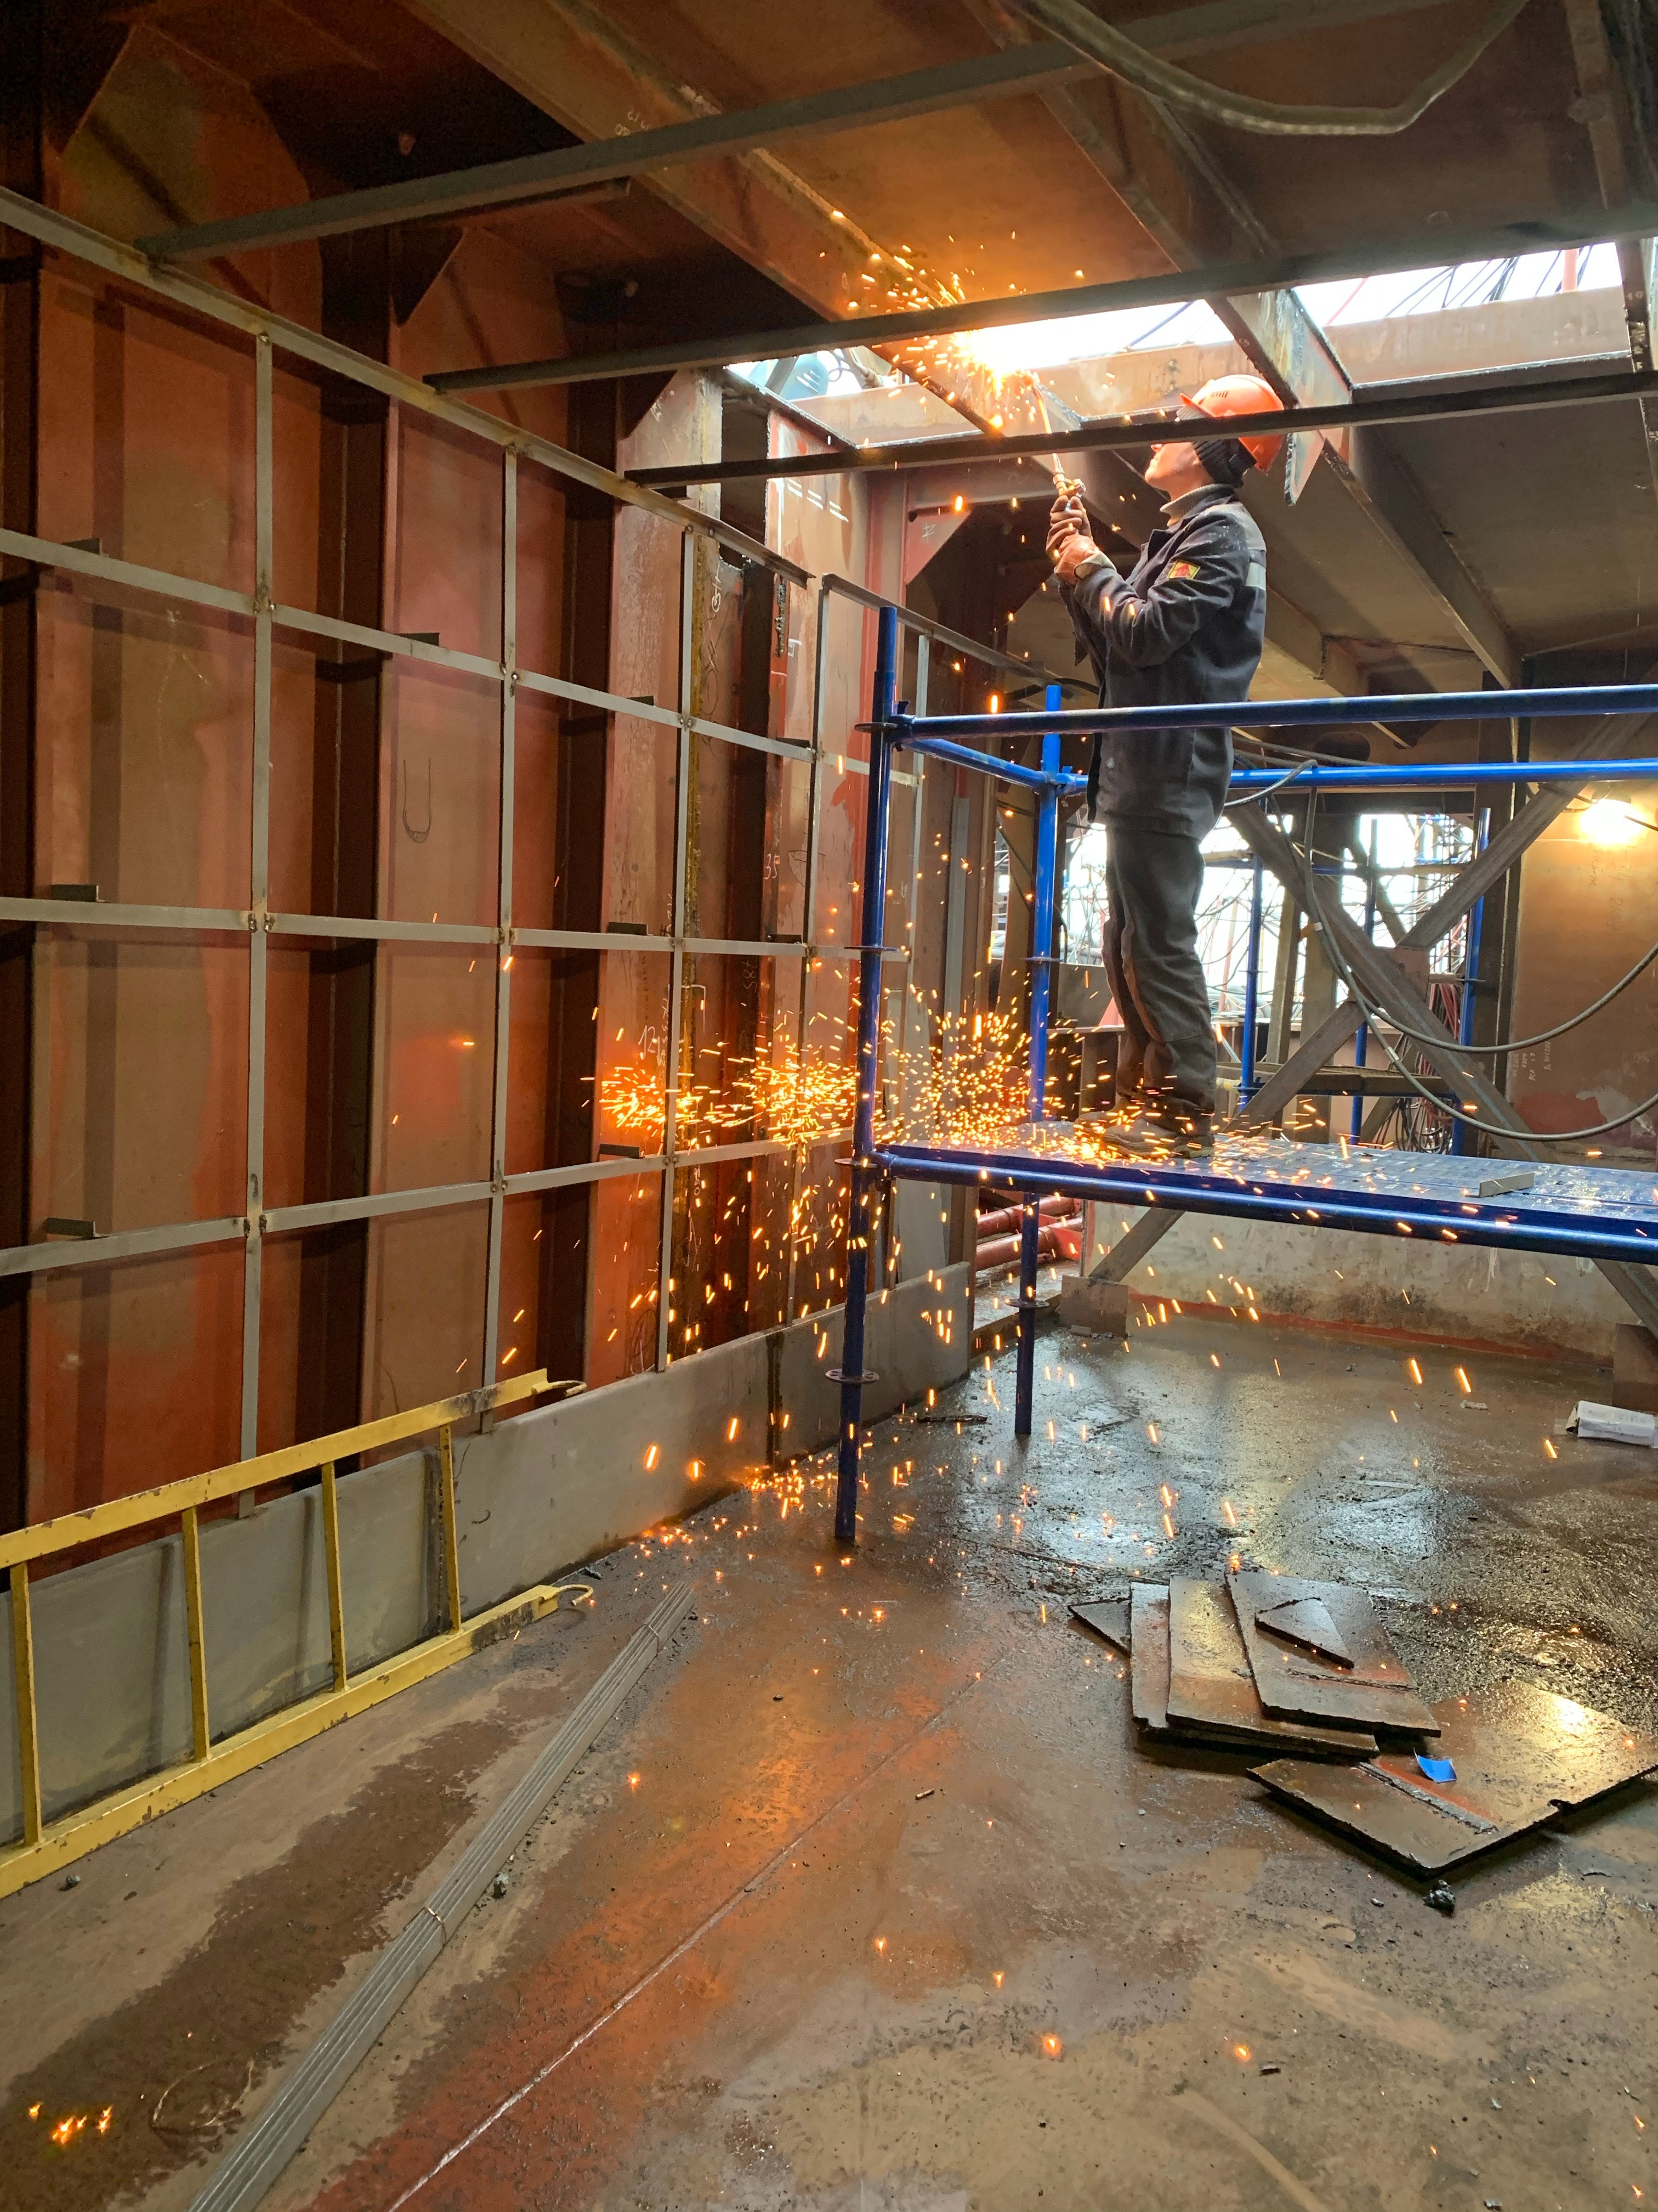
Components of Contractor Safety Management
Who is considered an operator?
What is a contractor?
Contractor Pre-Qualification
Training and Orientation
Pre-Job Task and Risk Assessment
Job Monitoring
Post-Job Evaluation

Slide 3
Who is considered an operator?
Section 3(d) of the mine act states that an operator is”…any owner, lessee, or other person who operates, controls, or supervises a coal or other mine, or any independent contractor performing services or construction at such mine…”
Contractors are considered operators and all operators have a duty to comply with the act.
This all stems from MSHA vs. Phillips Uranium Corp. Division (1982) – 2.
Two Prong Test:
The independent contractor’s proximity to the extraction process, whether work is sufficiently related to that process, where its employees are exposed to mining hazards, and have a direct effect on the safety of others.
The extent of the contractor's presence at the mine:
If a contractor has frequent exposure to mine hazards occurring intermittently and repeated over time and if a contractor has extended exposure to mine hazards for more than 5 consecutive workdays.

Slide 4
What is an independent contractor?
45.2 (c) Independent contractor means any person, partnership, corporation, subsidiary of a corporation, firm, association or other organization that contracts to perform services or construction at a mine
Contractors also must report the estimated annual hours worked at a mine site which means they will also need a contractor ID.

Slide 5
Contractor Pre-Qualification
Insurance Requirements
Based on type of work and risk
Company named as an additional insured
Contract management, Master service agreements, PO’s Vs. P-Cards
Certificate of Insurance management
Safety Evaluation
MDRS
Verification on safety policies and procedures
Part 46 Training (new miner training, newly hired experienced miner training, new task training, site specific and annual refresher training)
2 week waiting period from development to implementation
Verify documentation
Is the contractor qualified for the scope of work?
Hire or no Hire?

Slide 6
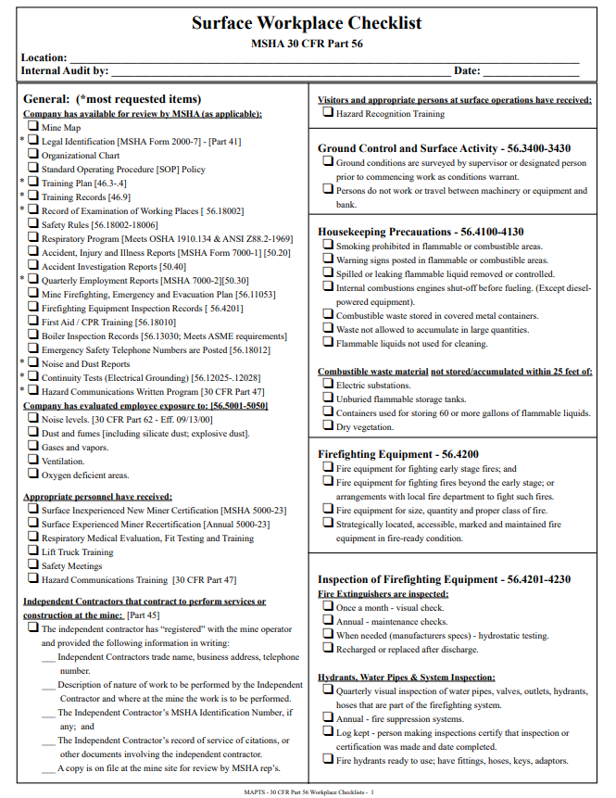
Checklists
Checklists ensure that you don’t miss anything whether they are for contractors or for the operation in the form of an internal inspection.

Slide 7
Training and Orientation
Site specific training provided and documented
Accident reporting
Workplace exams – Competent person, immediate notification
Equipment inspections
Site specific policy reviews
Review of authorized work areas for contractors
Anything else that needs to be covered?

Slide 8
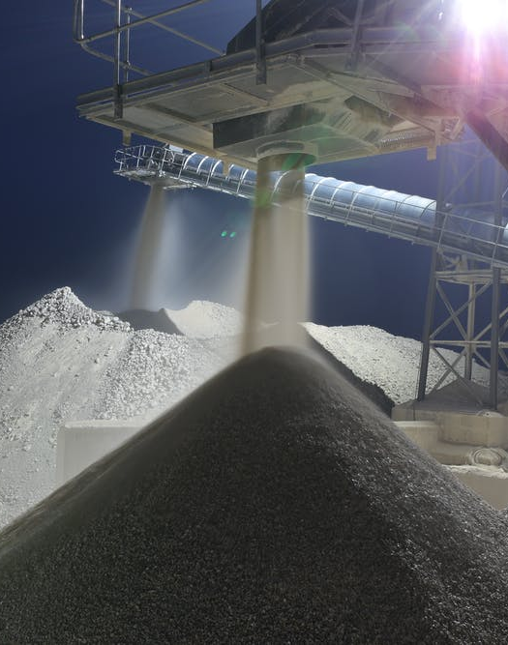
Pre-Job Task and Risk Assessment
Review the scope of work
Identify hazards and document
Create methods to eliminate or control hazards and document
Implement hazards controls
Document risk / hazard assessments

Slide 9
Job Monitoring
Direction of control Vs. My house, My rules
What frequency of monitoring is needed?
Who monitors?
What if there is a safety issue?
Shut down? Let someone know? Handle it?
Correct any deficiencies immediately.
Document the interactions.
Contractor questions / concerns?

Slide 10
Post-Job Evaluation
Were there any safety issues?
Is the work site clean?
Are all guards and covers back in place?
Are all locks removed?
Equipment tests?
Were they on time?
On budget?
Overall performance?
Hire again?

Slide 11
Questions?
www.GEW-LLC.com
Dan Donovan – 206.399.8801
dandonovan@GEW-LLC.com

